Slide 1

RU F.I.T Ministries

Slide 2

The F.I.T. of RU FIT =
F-aith I-nfluencing T-oday where you live, work, and Play both physically and spiritually

Slide 3
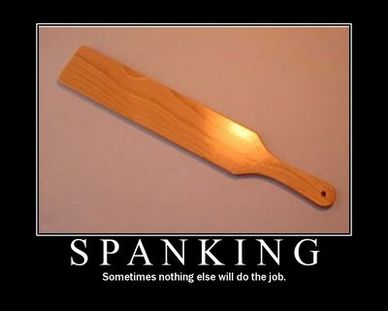
Remember when your parents would discipline you and say, “This hurts me more than it hurts you … it’s because I love you.” Well ….

Slide 4

The Church in America is Obese Physically …

Slide 5
Startling “Church” Statistics:
1. (SBC) 75% of Christians are seriously overweight. Compared to only 65% of general public
2. (Pastors and Pulpit) 76% of pastors are obese

Slide 6
More Startling Statistics by 2030:
1. $66 billion in health care expenses due to lack of Fitness
2. 7.8 million new cases of diabetes
3. 6.8 million new cases of stroke and heart disease
4. 539,000 new cancer diagnoses due to lack of fitness

Slide 7
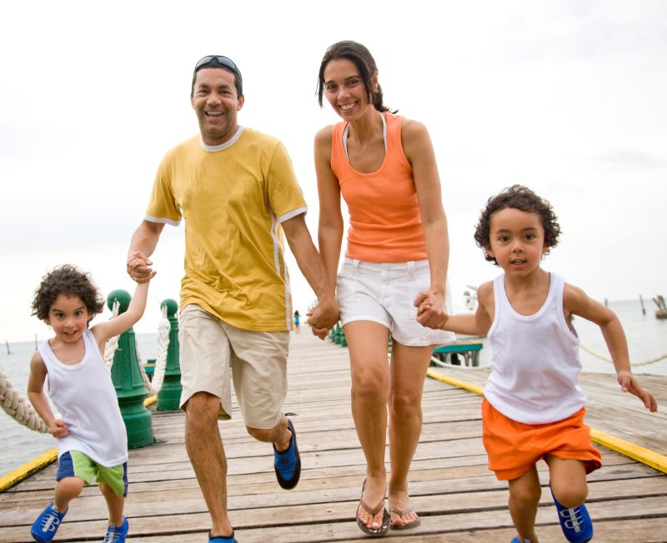
This threatens futures of individuals, families, churches and our nation

Slide 8
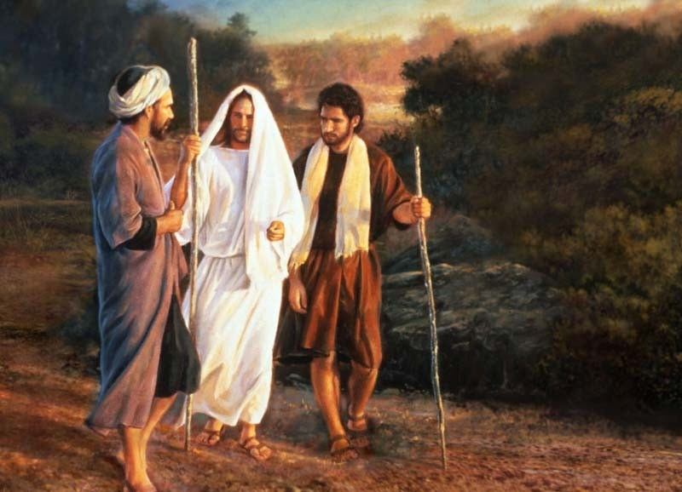
Question: If you were alive on this earth when Jesus and Paul walked (in your current body) .. Could you walk with them … LITERTALLY?

Slide 9
Of all groups of people in America, we should be the #1 group to deal with this issue!
Why?....

Slide 10
1Co 6:19 What? know ye not that your body is the temple of the Holy Ghost which is in you, which ye have of God, and ye are not your own?
1Co 6:20 For ye are bought with a price: therefore glorify God in your body, and in your spirit, which are God's.

Slide 11

I said earlier I don’t apologize for sharing this truth … here is why …

Slide 12
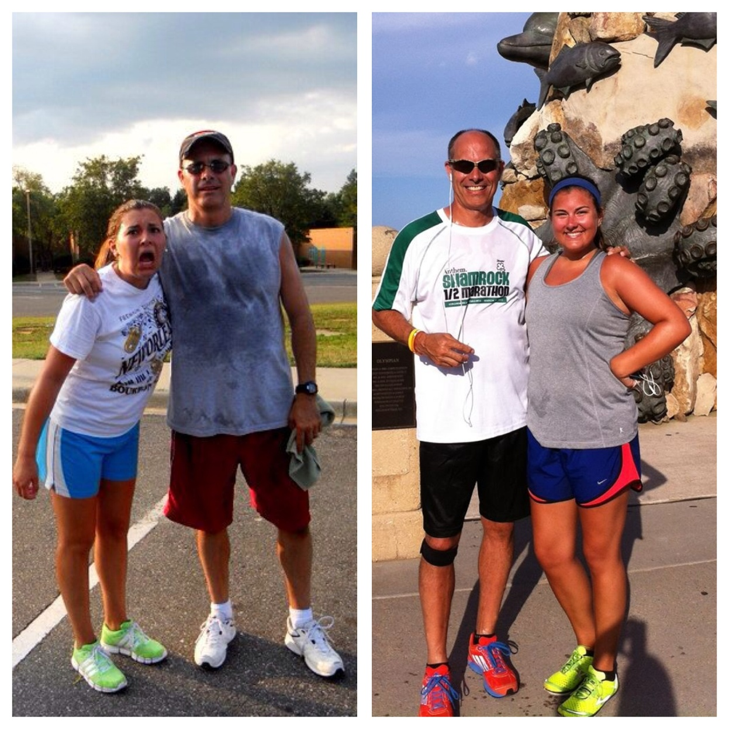
IT SAVED MY LIFE!!!!!

Slide 13
Not long ago I was:
1. 240 lbs
2. Cholesterol was 200 pts. High
3. Triglycerides were high
4. Borderline diabetic
5. My back and knees hurt all the time

Slide 14
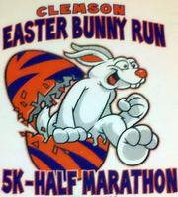
My “aha” moment was in April of 2011 when I watched Andrea complete her first 13.1 @ Clemson, SC

Slide 15
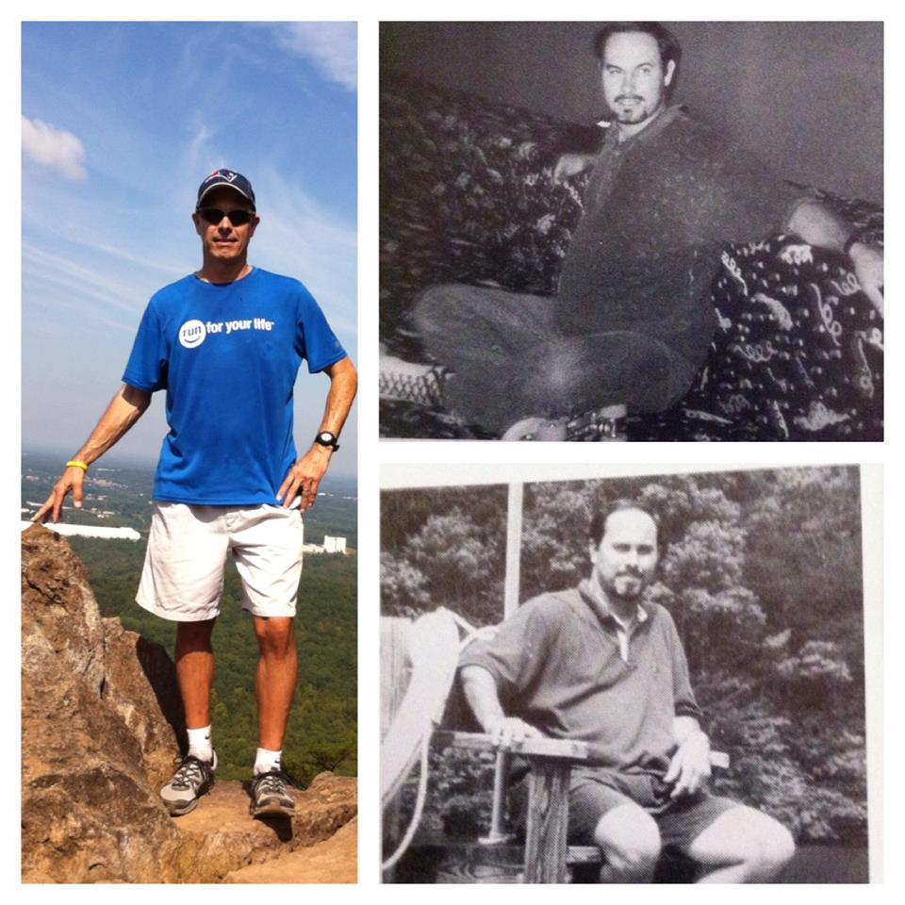
I committed to coming back next year and running a (oh my gosh) a 5K in (Impossible) 25 minutes!

Slide 16
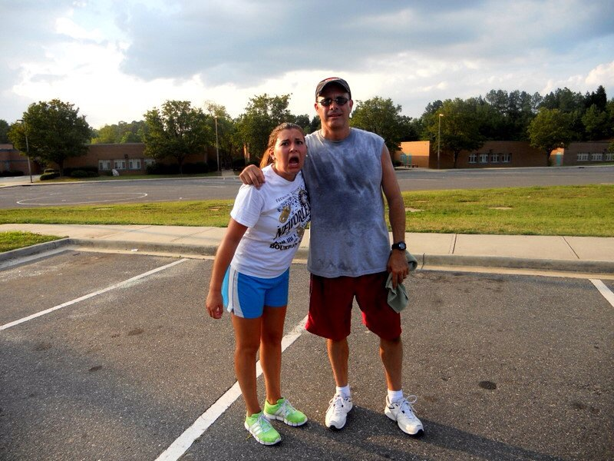
My 1st mile Since 1987 was in June of 2011 (3 months later) - 235 lbs

Slide 17
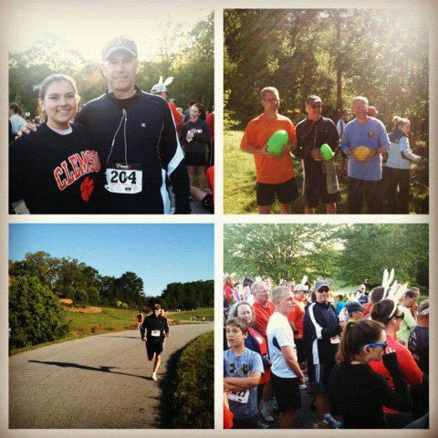
1 year later …
1. Finished in 25:11 (very hilly)
2. Placed 3rd in overall Masters
3. Weighed 180 lbs.

Slide 18
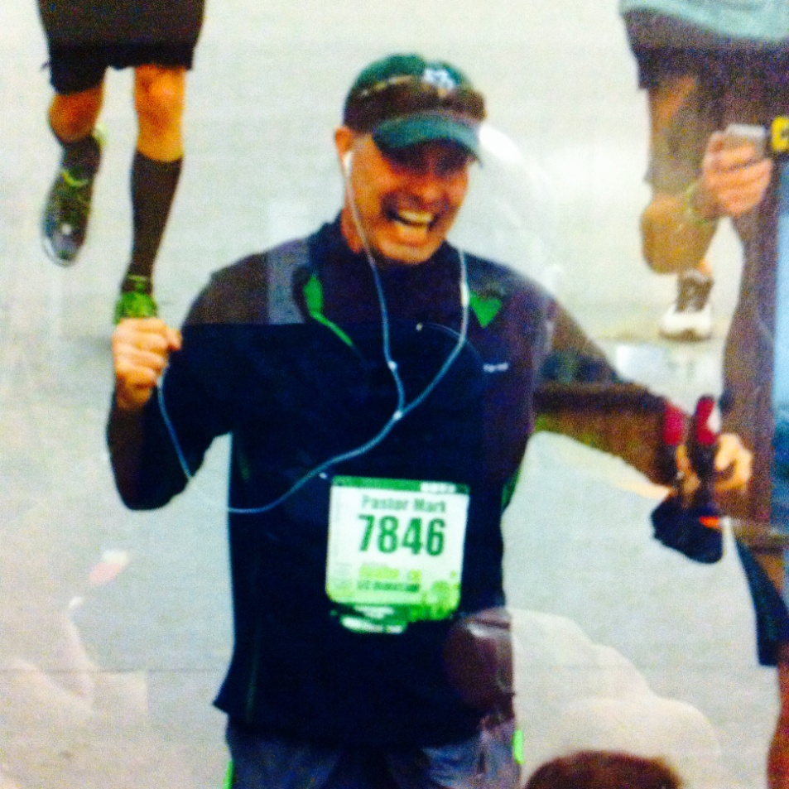
Another landmark came in March of 2013 when I finished my 1st 13.1 in 1:53:29 in Va. Beach

Slide 19
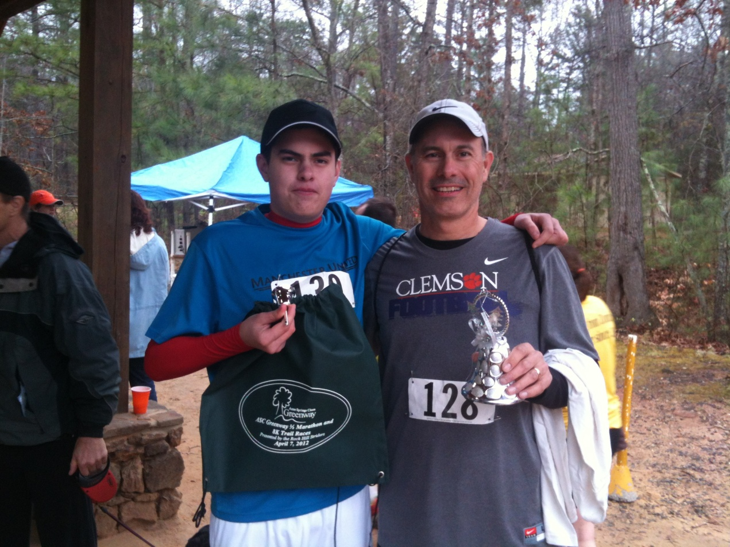
In 2.5 years I have raced in 25 combined races (5K to 13.1) and finished in top 3 of age in most

Slide 20
Not only is the church Physically obese …
…it is Spiritually obese as well

Slide 21

According to the Barna Group …
1. only 3% of Christians have led 1 person to Christ … ever
2. 90% of church growth is church transfer

Slide 22
Think about it …
The Average believer listens to a complete message for S.S. /Morning Worship / Evening Worship and Wednesday Evening

Slide 23
Think about it …
This does not include their personal devotions and other misc. avenues of teaching

Slide 24

Jesus compares walking with Jesus to running a race

Slide 25
1Cor 9:24
Know ye not that they which run in a race run all, but one receiveth the prize? So run, that ye may obtain.

Slide 26
The wording of this is interesting …
It says that ALL run the race, but that only SOME of the many (one) will obtain the prize.

Slide 27
That poses an interesting question … who are the (some of the all that run the race) and what are they seeking to obtain?

Slide 28

That is what the “Running Tips” of RU FIT Ministries are all about!

Slide 29
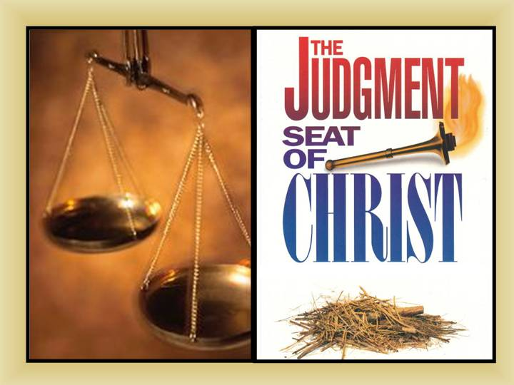
They are all purposefully designed to prepare people for the judgment seat of Christ!

Slide 30
Walking with Jesus is “LIKE” Running a Race …
Let’s notice some basic comparisons ….

Slide 31

Nutrition – This takes us back to how many messages we “take in” weekly

Slide 32
If we “take in” more spiritual nutrition than we “give out” in actual ministry then we are not healthy believers.
We are obese!

Slide 33
God uses the comparison of physical running to highlight what is needed for us to be healthy spiritually.

Slide 34
It’s not how much you eat … it’s WHAT you eat that is important.
Our “eating” must serve a purpose … it is not random.

Slide 35
Running Tip #1:
7 Stages of Spiritual Growth
I Peter 1:1-8

Slide 36
Running Tip #2:
Qualities of a Spiritual Warrior
Nehemiah Study

Slide 37
Running Tip #3:
How to walk with God using articles of the OT Tabernacle as teaching tool
I Cor. 10:11

Slide 38
Running Tip #4:
Witness to anyone using the 7 Mysteries given to the church through Paul
I Cor. 4:1

Slide 39
Running Tip #5:
The believers identity crises
John 1:12

Slide 40
Running Tip #6:
Rightly dividing the Word of Truth
II Tim. 2:15

Slide 41
Running Tip #7:
Understanding the unseen realm (The real Angels and Demons)
Ephesians 6:11-18

Slide 42
Running Tip #8:
Witnessing through the Mazzaroth (Zodiac)
Romans 1 / Job 38:32

Slide 43
Running Tip #9:
Secrets of the judgment seat of Christ
II Cor. 5 / Job

Slide 44
Running Tip #10:
The 4 Goals of Biblical Discipleship
II Timothy 2:2

Slide 45
Running Tip #11:
Keys that Unlock the Bible
Isaiah 22:22

Slide 46

Here’s How RU FIT Ministries Work

Slide 47
RU FIT Challenge
(Friday PM & Saturday AM)

Slide 48
Friday PM:
Choose a “Running Tip” for
Spiritual FITness Equipping

Slide 49
Saturday AM:
Participate in 5K
Run/Walk/Jog

Slide 50
Awards:
-Everyone gets an Award
-Anyone who finishes before me gets a medal

Slide 51
Other RU FIT Opportunities:
1. Youth Camps
2. Retreats
3. Christian School FITness Emphasis
4. Christian College FITness Emphasis
5. Running Paraclete’s Local Clubs
6. Online Discipleship

Slide 52
These “Running Tips” will give us the ability and confidence to “convince the gainsayers”
They reveal to others that we understand God’s plan for our lives, this earth and the universe.

Slide 53
I leave you with this word of encouragement as you begin your journey to GET and STAY physically and spiritually F.I.T.

Slide 54
1Jn 5:14 And this is the confidence that we have in him, that, if we ask any thing according to his will, he heareth us:
1Jn 5:15 And if we know that he hear us, whatsoever we ask, we know that we have the petitions that we desired of him

Slide 55

Visit our table for more information about
RU FIT Ministries

